Slide 1


E-Learning Platform Overview
This ASP.NET Core-based platform connects instructors and students for engaging, feature-rich online education.
It offers comprehensive tools supporting interactive learning and course management.
by Bakareke Andrew

Slide 2
Student Features
Course Catalog & Enrollment
Interactive Learning
Personal Dashboard
Engaging content with quizzes and assignments
Monitor overall learning and upcoming tasks
Browse detailed course descriptions
Progress tracking per module
Access enrolled courses and performance metrics
Smooth, card-based UI with progress visuals
Certification upon completion
Track enrollment and course progress

Slide 3

Instructor Capabilities
Course Management
Assessment Tools
Design quizzes, grade assignments, provide feedback, and monitor student performance.
Create, edit, and organize course modules with prerequisites and materials upload.
Analytics Dashboard
Analyze engagement, completion rates, and quiz results for informed decisions.

Slide 4

Technical Backend Stack
Framework
Database
ASP.NET Core 8.0 for scalable, high-performance backend services
SQL Server managed via Dapper ORM and Entity Framework Core
Security
ASP.NET Core Identity supports role-based authorization and session protection

Slide 5
Front-End Technologies
Core Tools
UI Design
Razor Pages for dynamic UI rendering
Custom CSS with clean typography
Bootstrap 5 ensures responsive design
Card-based layouts with smooth animations
JavaScript/jQuery for interactivity
Intuitive navigation and forms

Slide 6
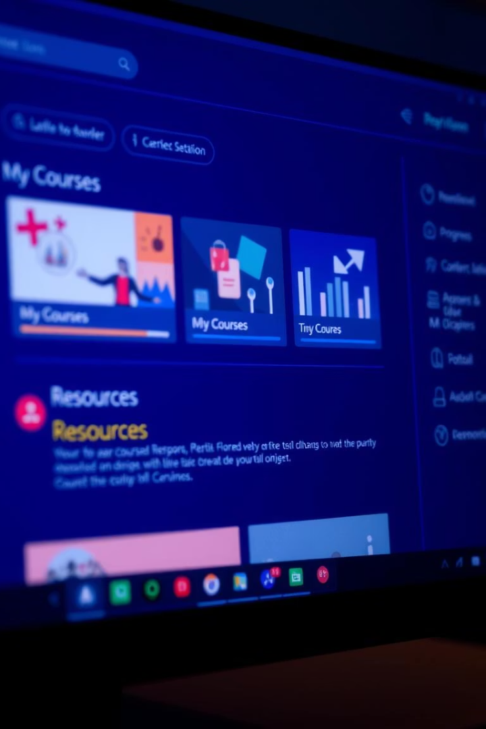



User Interface Highlights
Responsive Layout
Optimized for any device and screen size
Progress Indicators
Visual tracking for courses and modules
Certificate Generation
Automatic validation and issuance after course completion

Slide 7
Core Platform Components
User Management
Handles authentication, roles, and profiles
Course Management
Supports creation, organization, and enrollment
Content Delivery
Ensures smooth access to multimedia educational content
Assessment Engine
Manages quizzes, assignments, grading, and feedback
Progress Tracking
Provides real-time learning analytics and reports

Slide 8

Summary & Next Steps
Robust architecture
User-centric design
Ensures scalability, security, and performance
Delivers engaging experiences for students and instructors
Future enhancements
Focus on AI-driven personalization and mobile app expansion

